Slide 1
TPH WHATSAPP GROUP DATA ANALYSIS
Exploratory Report Name: Mowaninuola Umarudeen
Role: Data Analyst Date: 06/05/2025

Slide 2

INTRODUCTION
The TPH WhatsApp group is the official online community for The Publishers House (TPH), a church located at The House of Bread, Korinjoh House, Opposite Shawarma and Grills, British, Jos, Nigeria.
The group is primarily used for communication among members, workers, and leaders of the church. It is also used to share updates, and celebrate life moments like birthdays and anniversaries.

Slide 3
REASON FOR ANALYSIS I chose to analyze this group to better understand our online communication culture on WhatsApp and share insights that may be useful to our Pastor and the church family.

Slide 4
These are some of the questions I hope to answer in this analysis:
Who celebrates birthdays the most 🎉
The most common words we use
The emotional tone of our conversations
Peak hours and days of message activity
Who sends the most messages and gets the most responses
How quickly we respond
Who consistently engages the most
And how many of our 274 members are active participants
It’s a look into what our group chats reveal about us as a spiritual family

Slide 5
LET’S TAKE A LOOK AT OUR ANSWERS

Slide 6
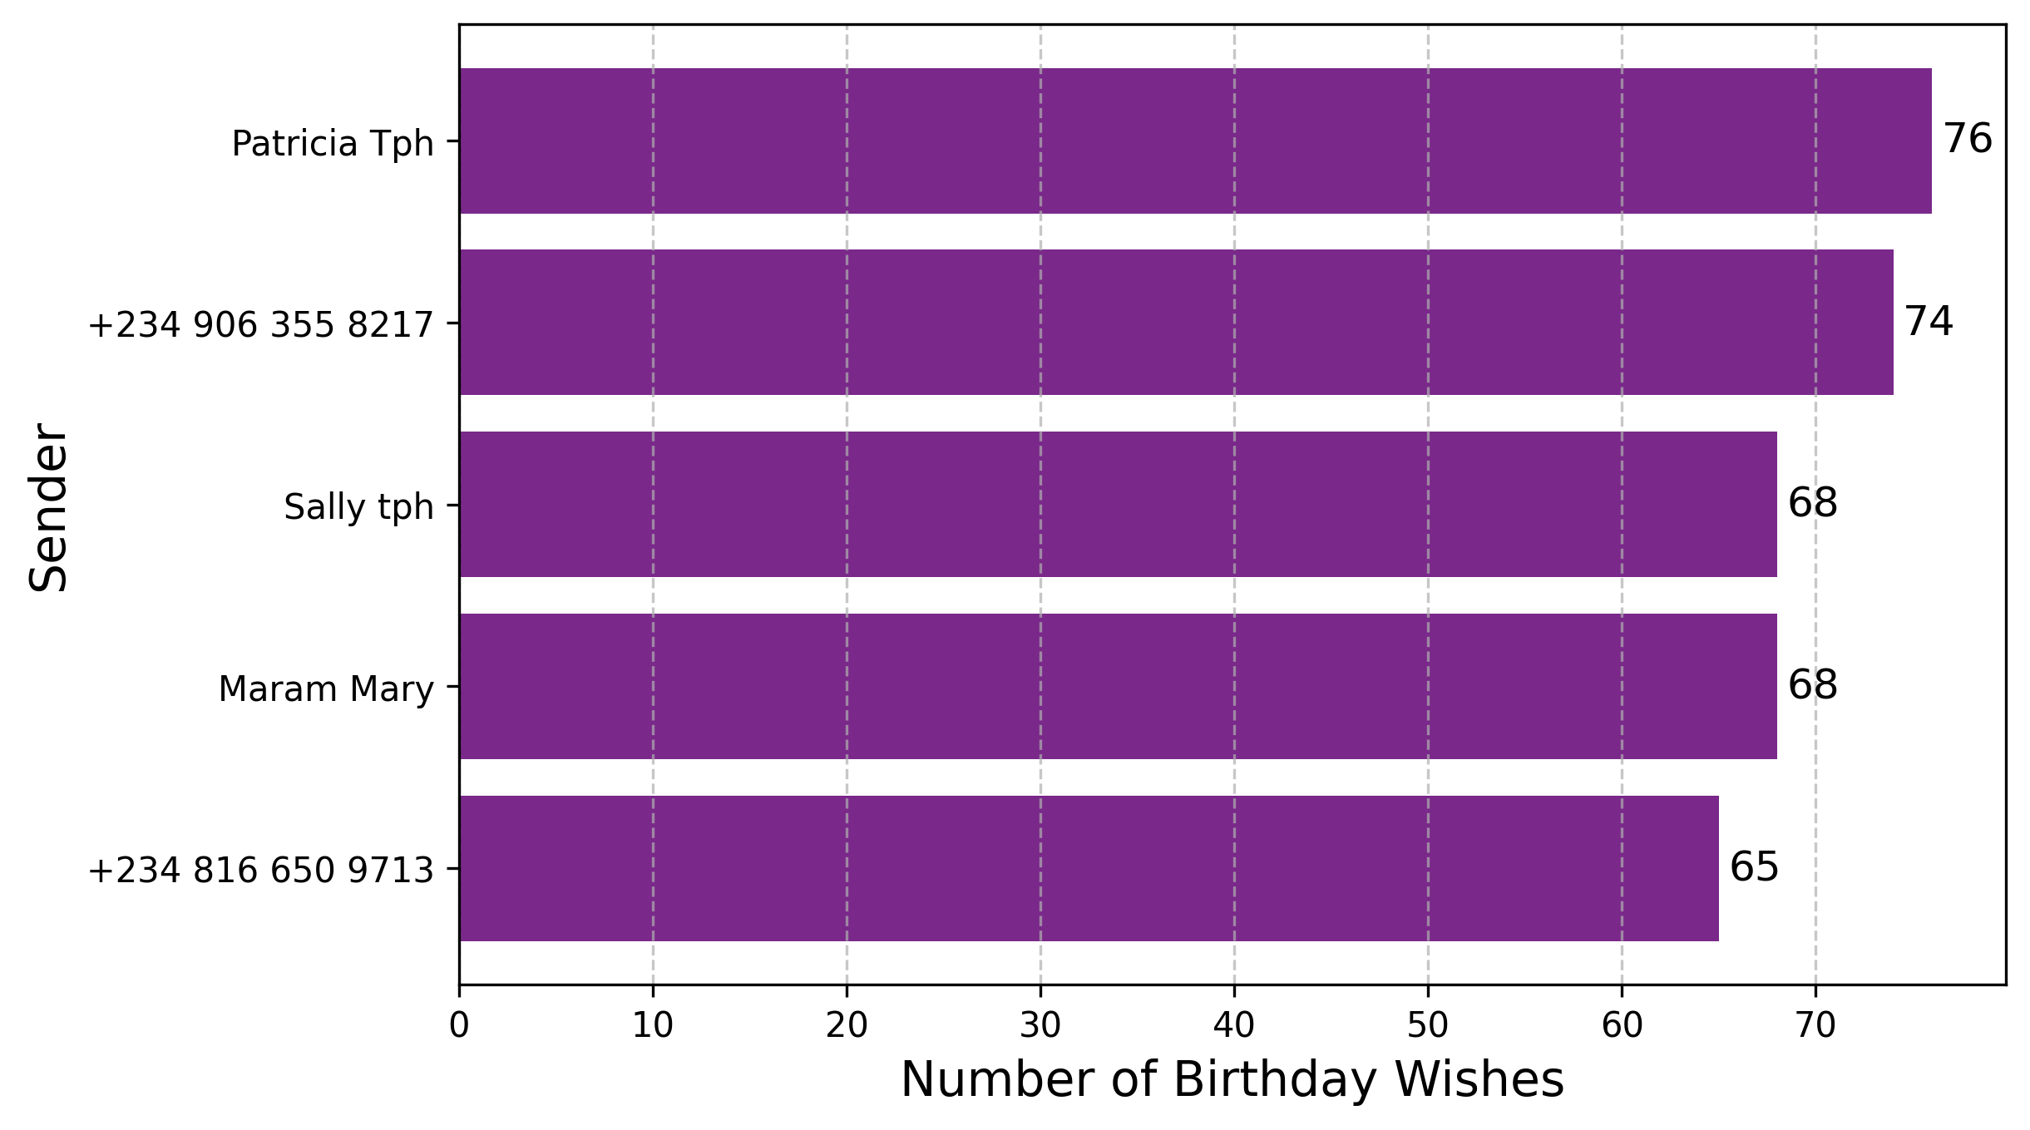
TOP 5 BIRTHDAY WISH SENDERS
Patricia Osifo leads with 76 wishes, followed by ThankGod Watsawda (74), Sally Abarshi and Maram Mary (68 each), and Okoko Lawrencia (65)

Slide 7
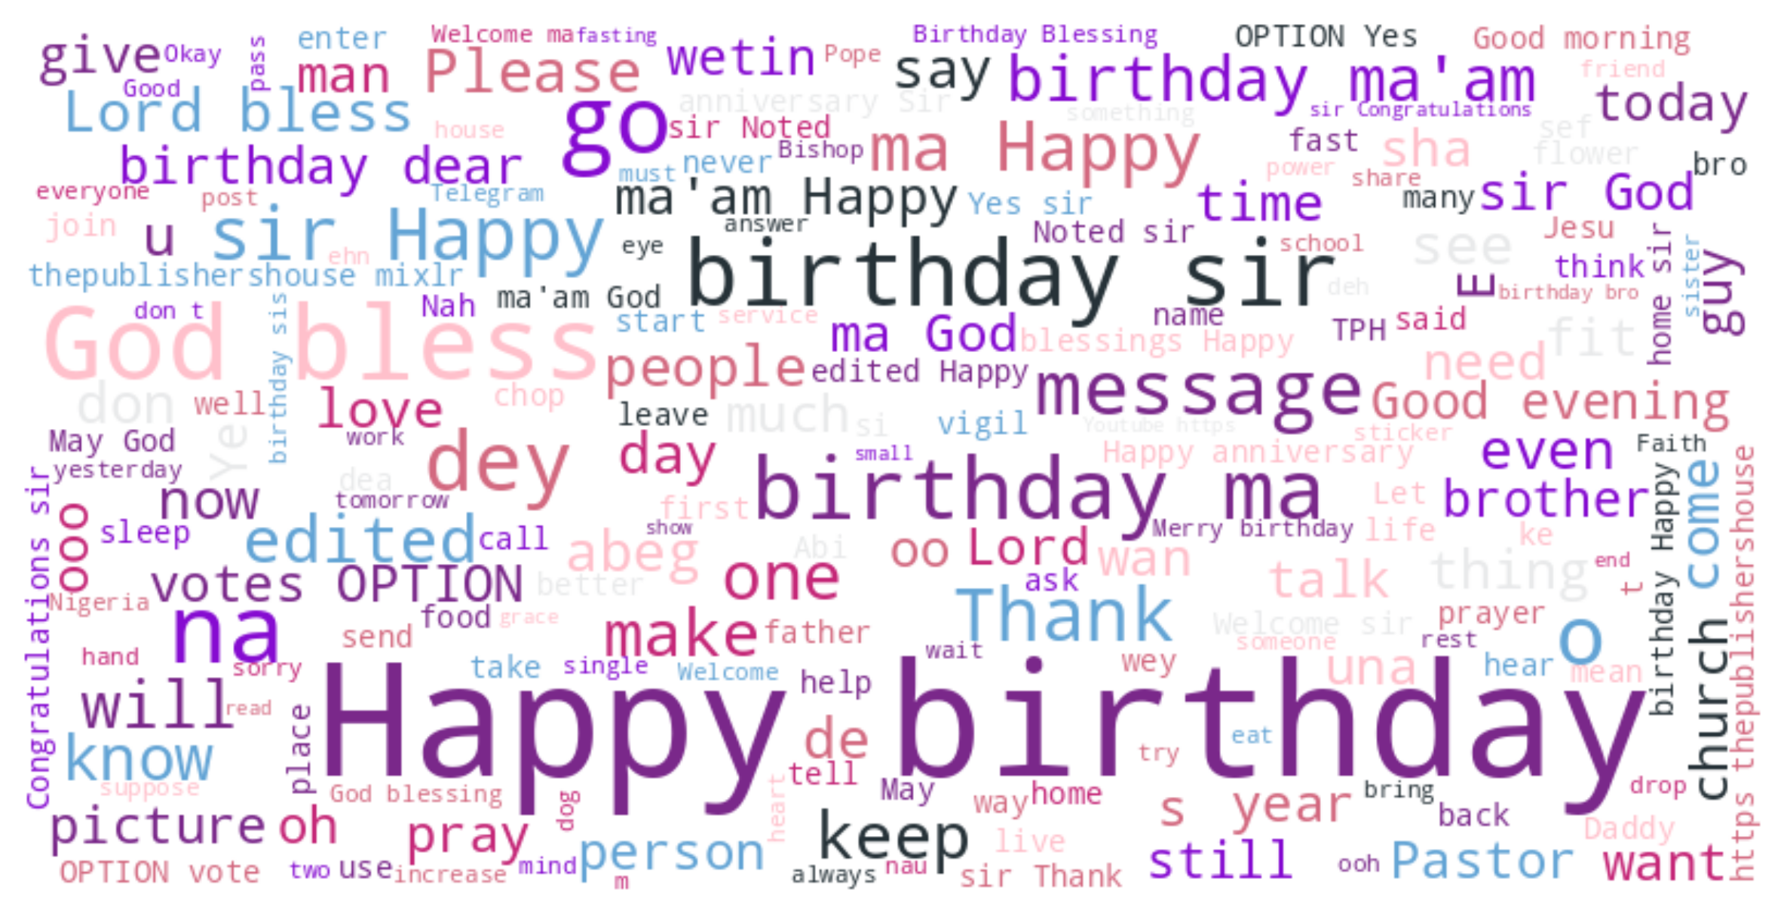
MOST COMMON GROUP WORDS
It is visually clear that ‘Happy Birthday’, ‘birthday sir/ma’, ‘God bless’, and ‘prayer’ dominate the conversations. This shows our group’s strong culture of celebration, encouragement, and spiritual connection.

Slide 8
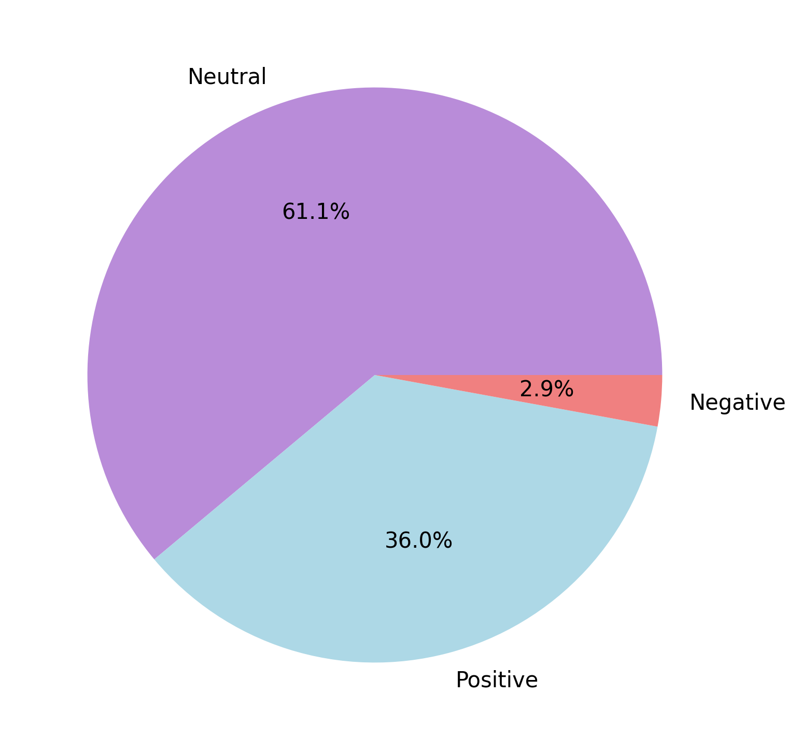
WHAT OUR CONVERSATIONS SAY ABOUT US
According to analysis: 😂 We play and gist a lot (61%): These are normal, everyday talk like coordination, planning, humor, jokes, announcements, and passing information.
🎉 But we also celebrate people (36%): Reflecting a very strong culture of celebration, blessings, encouragement, and good wishes!
🤝 And we have almost no negativity (3%) and even that feels more like jokes or playful teasing than real conflict.

Slide 9
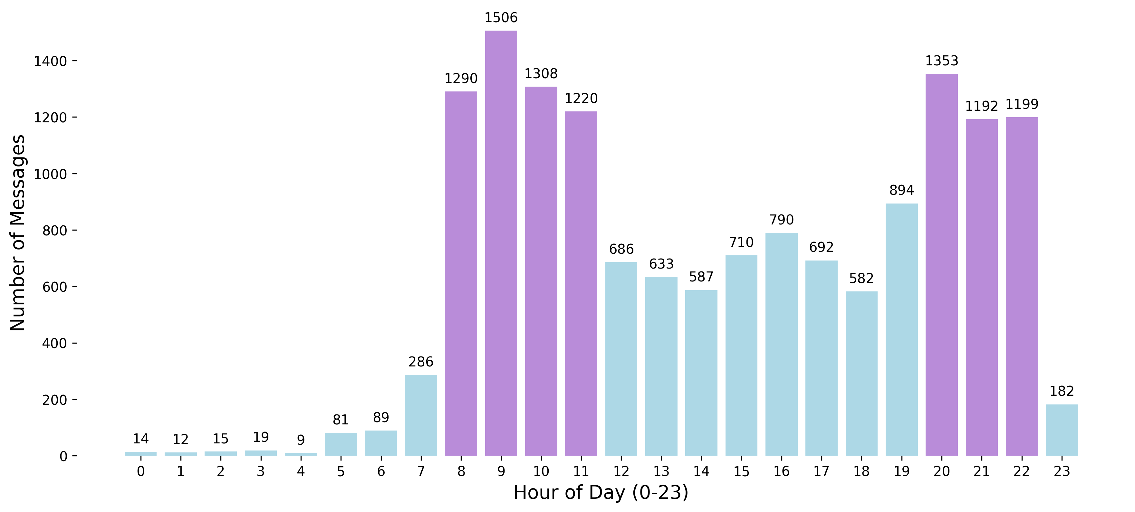
OUR MOST ACTIVE HOURS
This chart shows the hours when we talk the most, morning (8 AM–11 AM) and evening (8 PM–10 PM). Purple bars highlight the top 7 most active hours, while blue bars show the quieter times.

Slide 10
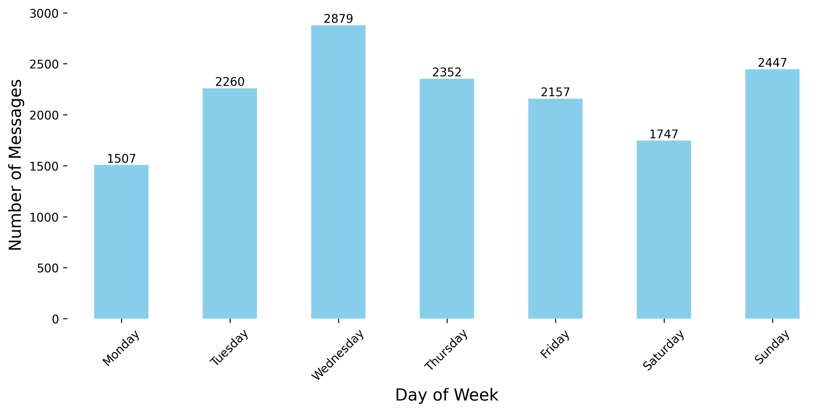
MESSAGE ACTIVITY ACROSS THE WEEK
People talk more on Wednesdays while Monday is the quietest.
People are quite active from Tuesday to Friday, showing consistent midweek engagement.
Sunday is more active than Saturday, possibly because people are reconnecting or preparing for the week.
Overall, this chart shows that MIDWEEK is when people talk the most.

Slide 11
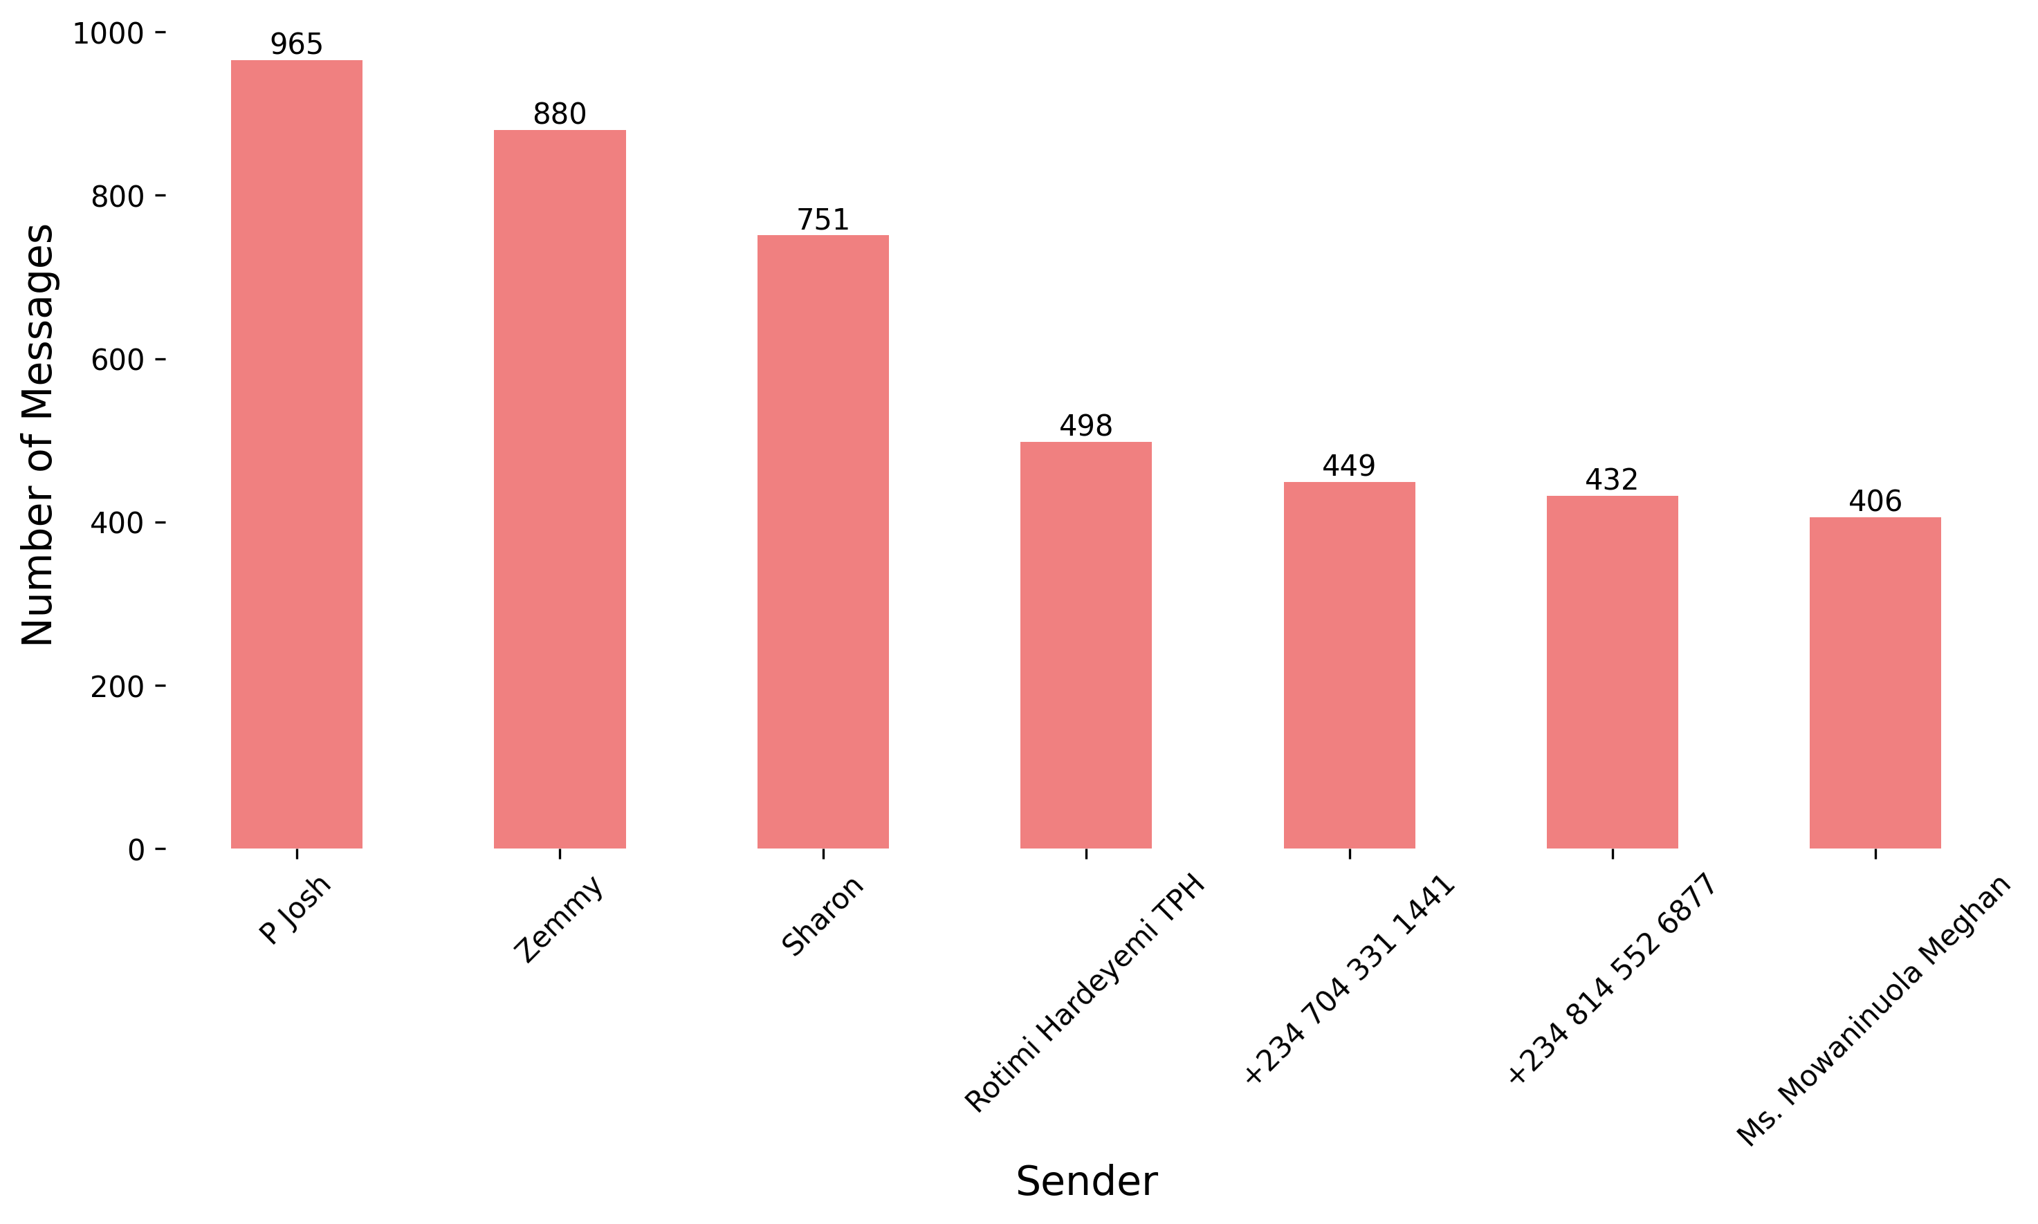
TOP 7 MOST ACTIVE GROUP MEMBERS
Dr. Josh, Zemnaan, and Sharon stand out for their consistent engagement on the group over the last four months.
It's also encouraging to see other contributors like Rotimi, Pope Delvan(449), Genesis (432), etc..

Slide 12
TOP 7 LEAST ACTIVE GROUP MEMBERS
Each of the following members and 19 others sent only 1 message during the analysis period :
Mr. Ammi Zoaka
Celestine TPH
Silas TPH
+234 811 968 8252 (The Last No in the Sons' Platform)
Peace Kadala
Gavou Yakubu
Victor Gabriel TPH

Slide 13
MEMBERS RESPONSE TO MESSAGES
Average Response Time: 13.48 minutes
Most Common Response Time (Median): 0.00 minutes
This means that most members reply almost immediately, showing that the group is very active and quick to respond.
A few slower replies increase the average to 13 minutes, but overall, the group chats are lively and responsive.

Slide 14
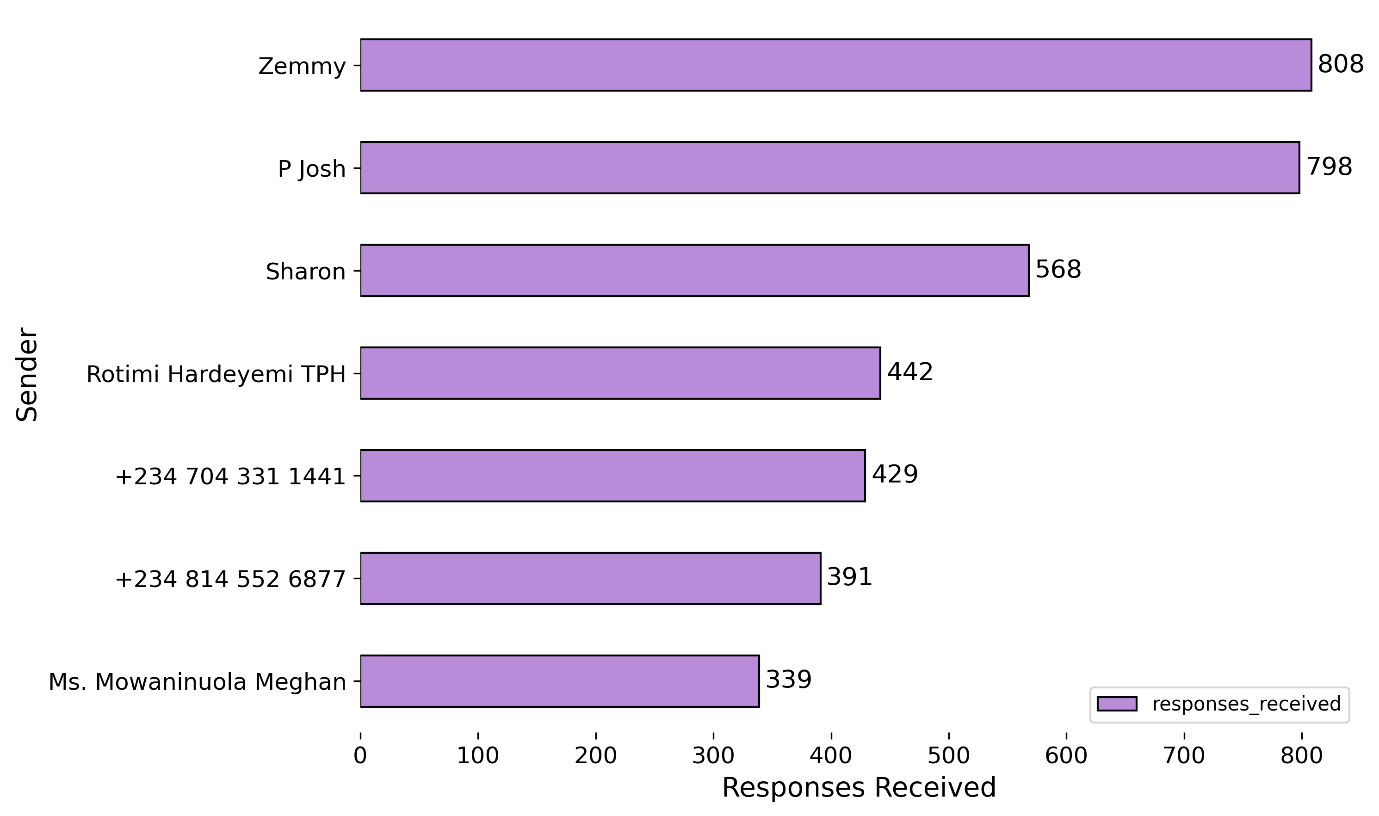
TOP 7 MSG SENDERS WHO GETS REPLIES
Zemnaan, P Josh, Sharon, Rotimi, Pope Delvan (429), Genesis (391), etc. get more replies than others.
And their messages are the most likely to get replies too by analysis.
This shows they share helpful content and keep the group active.

Slide 15
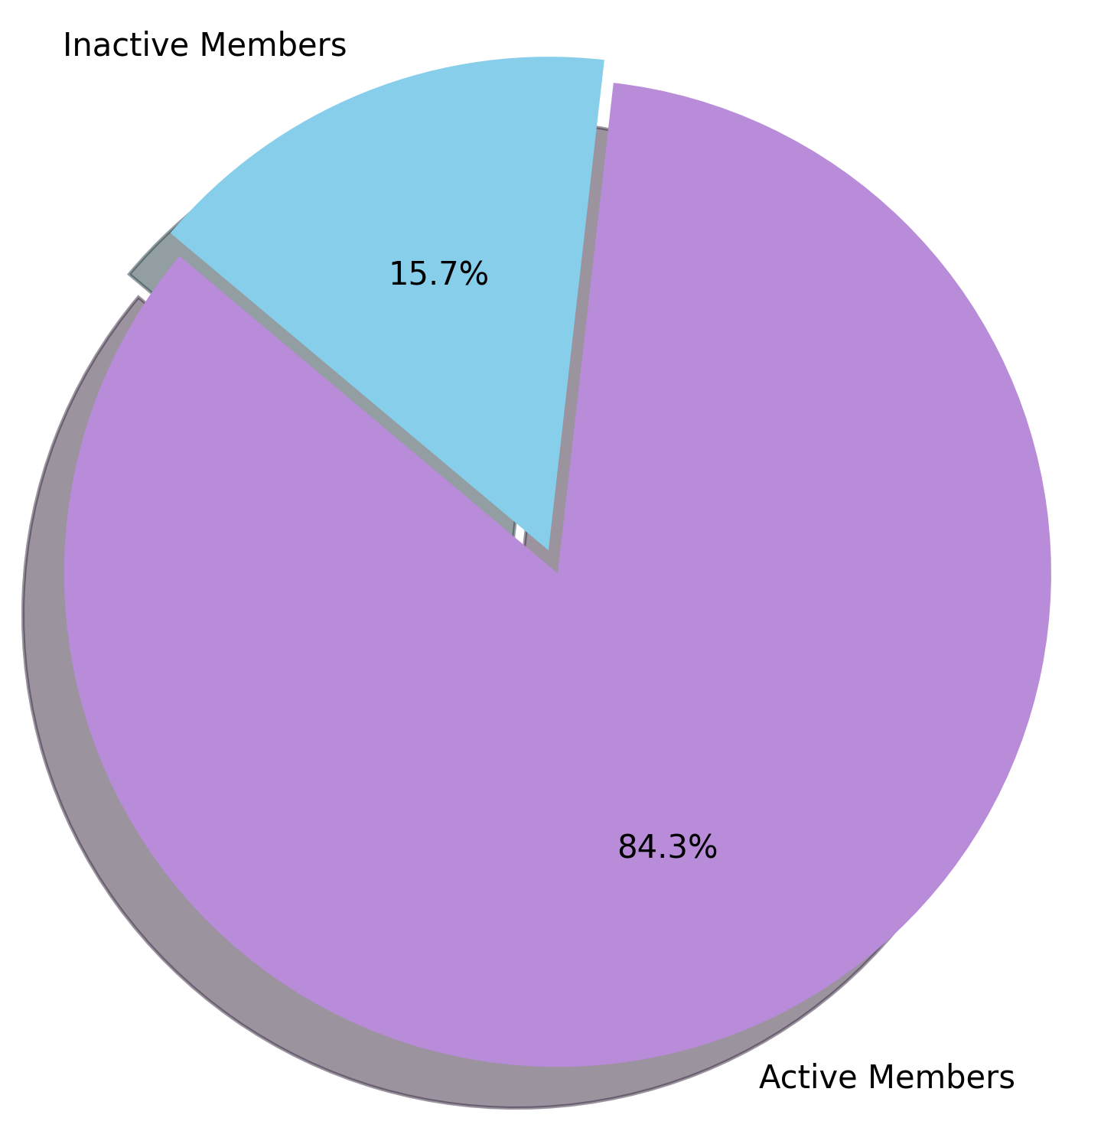
GROUP PARTICIPATION (ACTIVE VS INACTIVE MEMBERS)
Out of 274 group members, 231 have sent at least one message.
That means: 🟢 84%, 231 members are active 🔴 16%, 43 members are not active
This suggests that we have healthy group dynamics, shared interest, and strong community culture.

Slide 16
SUMMARY OF GROUP CHAT INSIGHTS

Slide 17
🎉 Top Birthday Wish Senders:
Patricia Osifo – 76 wishes
ThankGod Watsawda – 74
Sally Abarshi & Maram Mary – 68 each
Okoko Lawrencia – 65
🗣️ Group Language Culture
Frequent phrases: “Happy Birthday,” “God bless,” “prayer”
Culture: Celebration & spiritual encouragement
💬 Conversation Breakdown
61% – Casual chats (planning, humor, info sharing)
36% – Celebratory & encouraging
3% – Mild teasing and bants

Slide 18
⏰ Chat Timing Most active: 8–11 AM & 8–10 PM Busiest day: Wednesday Quietest: Monday 🌟 Top Contributors P Josh, Zemnaan, Sharon, Rotimi, Pope Delvan, Genesis 💤 Least Active Members We showed the least 7 active members but there are 19 more people who sent only 1 message during the period

Slide 19
🔁 Response Patterns
Median reply time: Immediate (0 mins)
Average reply time: 13.5 mins
Indicates fast, responsive conversations
🙌 Engaging Senders
Zemnaan, P Josh, Sharon, Pope Delvan, Genesis
Their messages get most replies, showing influence & helpfulness
📊 Overall Engagement
84% of members are active (231 out of 274)
Reflects a highly engaged, responsive community

Slide 20
CONCLUSION

Slide 21
This is not a business report, and that’s why I’m not making any formal suggestions or including a “Recommendations” section. However, we can consider doing the following:
1. Make use of Best Times to Post
Schedule important announcements or discussions between 8–11 AM or 8–10 PM, especially midweek.
Avoid Mondays for heavy posts since it’s the quietest.
2. Encourage Fast, Responsive Culture
The median reply time is 0 mins. Excellent!
Let’s preserve this by discouraging ghosting and thanking people for responding quickly.
Overall, this analysis provided a clear view of how the TPH WhatsApp group engages over time. From top contributors to peak activity periods, the data reflects the life and rhythm of our community.
It’s a beautiful reminder that what goes on, on the group matters.

Slide 22
Thank You for Viewing this Analysis. I'm open to your questions, thoughts, or feedback. Reported by: Mowaninuola Umarudeen Contact: 09056187698 (Call or WhatsApp) The full documentation will be available on GitHub at: TPH_Whatsapp_Group_Analysis.git

